Slide 1



SALES DATA ANALYSIS
View in Power BI
Last data refresh:
27/05/2025 06:44:55 UTC
Downloaded at:
24/03/2026 03:07:22 UTC

Slide 2
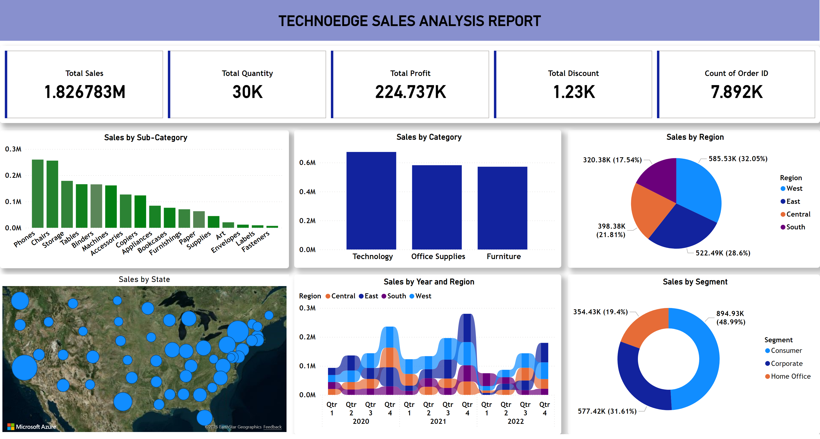
Sales analysis report
Notes:
Sales by Sub-Category
No alt text provided
Sales by Region
No alt text provided
Sales by Segment
No alt text provided
Sales by Category
No alt text provided
Sales by Year and Region
No alt text provided
actionButton
No alt text provided
Sales by State
No alt text provided
cardVisual
No alt text provided

